Slide 1


University Database
Team- Analytical Control
Hugh-John Dunkley: hdunk1@unh.newhaven.edu
Rogan Gopi: rgopi1@unh.newhaven.edu
Grace Mandada: gmand3@unh.newhaven.edu
Bhargavi Gottumukkula: gbhar1@unh.newhaven.edu
Samuel Mandada: smand17@unh.newhaven.edu

Slide 2
contents
Introduction
Objectives System
Overview
User Types & Assumptions
Hardware Requirements
Software Requirements
Safety & Security Requirements
Model Future Plans
Conclusion
Data Base Table Design Analysis

Slide 3

Introduction
The project “University Database” is developed in mysql and python
Like Inserting, Deleting, Editing university data information. Using this application admin can get all the information about student, faculty, department and course.

Slide 4
OBJECTIVES
It provides "better and efficient" service.
Faster way to get information about the students.
Provide facility for proper monitoring, reduce paper work and provide data security. All details will be available on a click for admin.
Reduce the workload of an institute.

Slide 5

SYSTEM OVERVIEW
The University database will be automated the traditional system. There is no need to use Paper and pen.
Checking a student details is very easy.
Adding new student record is very easy. Deleting or Editing a record of a particular student is simple.

Slide 6
USER TYPES
The users of the system are
Admin
The users should have sufficient knowledge of Computer & of English language. Because the user interface will be provided in English. The members should be part of the institute, where this software will be implemented.

Slide 7
SAFETY & SECURITY REQUIREMENTS
The program is very Safe and Protected.
Every types of user has Unique user ID and password to access their account.
Data security (My SQL Database connector)
Data Recovery
Data Protection
Data Grounding
Protection from Hackers

Slide 8
HARDWARE REQUIRMENT
Processor: Pentium 3.0 GHz or higher
RAM: 1024 Mb/1 Gb or more
Hard Drive: 10 GB or more
SOFTWARE REQUIRMENT
Operating System: Windows XP/7/8/8.1/10
Data base: My SQL connector
Language: Python

Slide 9
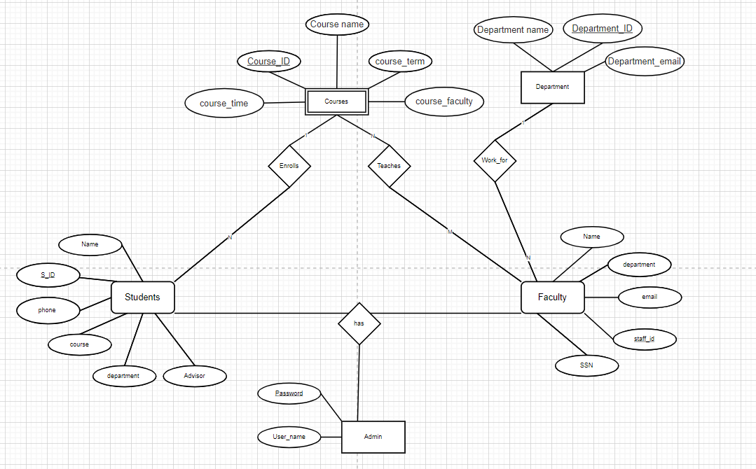
ER Diagram for university database

Slide 10

Sql code for database and student table
create database univ_database;
use univ_database;
CREATE TABLE student( id VARCHAR(20) primary key,name VARCHAR(20) NOT NULL,phone VARCHAR(10) NOT NULL,course VARCHAR(20) NOT NULL,department VARCHAR(20) NOT NULL,Advisor VARCHAR(20) NOT NULL);
insert into student values(001,'mike',2034556677,'database','computer science','michael'),(002,'steven',2034556678,'hacking','Cyber Security','mark'),(003,'lewis',2034556679,'statistics','industrial','john'),(004,'stuart',2034556680,'const_modeling','civil','george'),(005,'stuart',2034556681,'cell biology','Bio Technology','greg');

Slide 11
Sql code for Faculty table
CREATE TABLE faculty(
staff_id VARCHAR(20) primary key,
name VARCHAR(20) NOT NULL,
ssn VARCHAR(20) NOT NULL,
department VARCHAR(20) NOT NULL,
email VARCHAR(20) NOT NULL);
select * from faculty;
insert into faculty values(101,'michael',56455467,'computer science','mic@gmail.edu'),(102,'mark',99886545,'Cybersecurity','mark@gmail.edu'),(103,'john',22324356,'industrial','john@gmail.edu'),(104,'george',76568900,'civil','george@gmail.edu'),(105,'greg',67586758,'Bio Technology','greg@gmail.edu');

Slide 12

Sql database for department table
CREATE TABLE department( dept_id primary key VARCHAR(20) NOT NULL,dept_name VARCHAR(20) NOT NULL,dept_email VARCHAR(20) NOT NULL);
insert into department values(200,'computer science','cs@info.edu'),(201,'cyber security','cyber@info.edu'),(203,'industrial','indust@info.edu'),(204,'civil','civil@info.edu'),(205,'Bio Technology','bio@info.edu’);
select * from department;

Slide 13
Sql code for Course table
CREATE TABLE course(
course_id VARCHAR(20) primary key,
course_name VARCHAR(20) NOT NULL,
course_term VARCHAR(20) NOT NULL,
course_faculty VARCHAR(20) NOT NULL,
course_time VARCHAR(20)NOT NULL);
desc course;
select * from course;
insert into course values(601,'database','spring','michael','3:30-6:30'),(602,'hacking','fall','mark','1:30-3:30'),(603,'statistice','spring','john','2:30-5:30'),(604,'const_modeling','spring','george','10:30-2:30'),(605,'cell biology','fall','greg','8:30-10:30');

Slide 14
Database Table design Table-student data
Field | Type | Null | Key
id | varchar(20) | NO | Primary key
name | varchar(20) | NO
phone | varchar(10) | NO
course | varchar(20) | NO
department | varchar(20) | NO
Advisor | varchar(20) | NO

Slide 15
Database Table design Table-Department data
Field | Type | Null | key
dept_id | varchar(20) | NO | Primary key
dept_name | varchar(20) | NO
dept_email | varchar(20) | NO

Slide 16
Database Table design Table-Course data
Field | Type | Null | Key
course_id | varchar(20) | NO | Primary key
course_name | varchar(20) | NO
course_term | varchar(20) | NO
course_faculty | varchar(20) | NO
course_time | varchar(20) | NO

Slide 17
Database Table design for Faculty
Field | Type | Null | Key
staff_id | varchar(20) | NO | Primary key
name | varchar(20) | NO
ssn | varchar(20) | NO
department | varchar(20) | NO
email | varchar(20) | NO

Slide 18
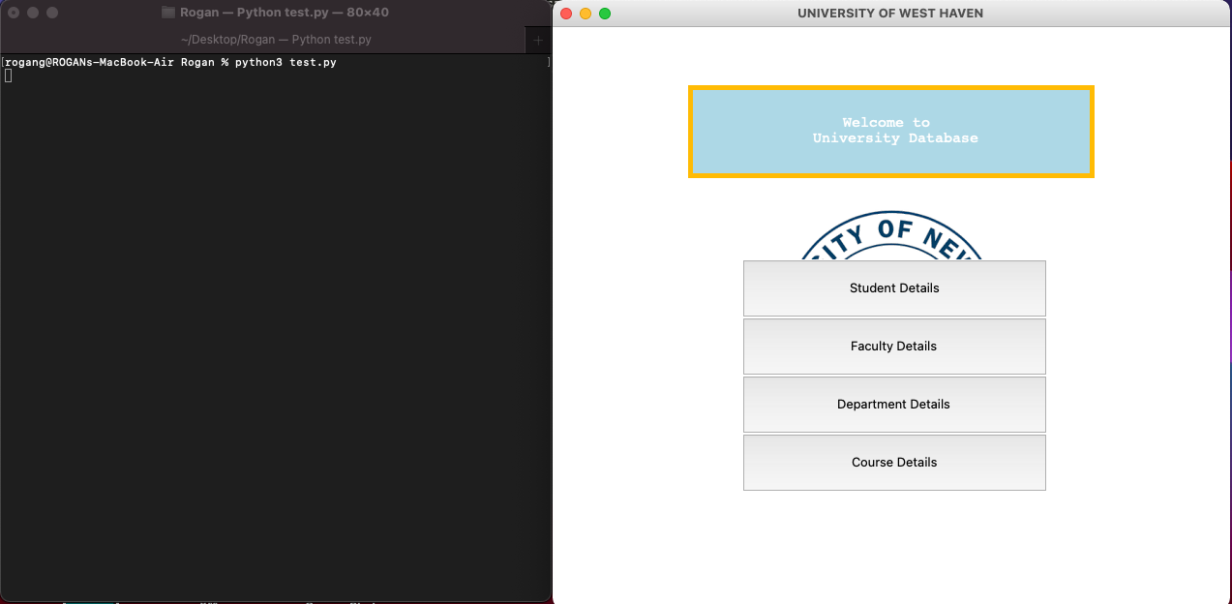
Welcome page

Slide 19
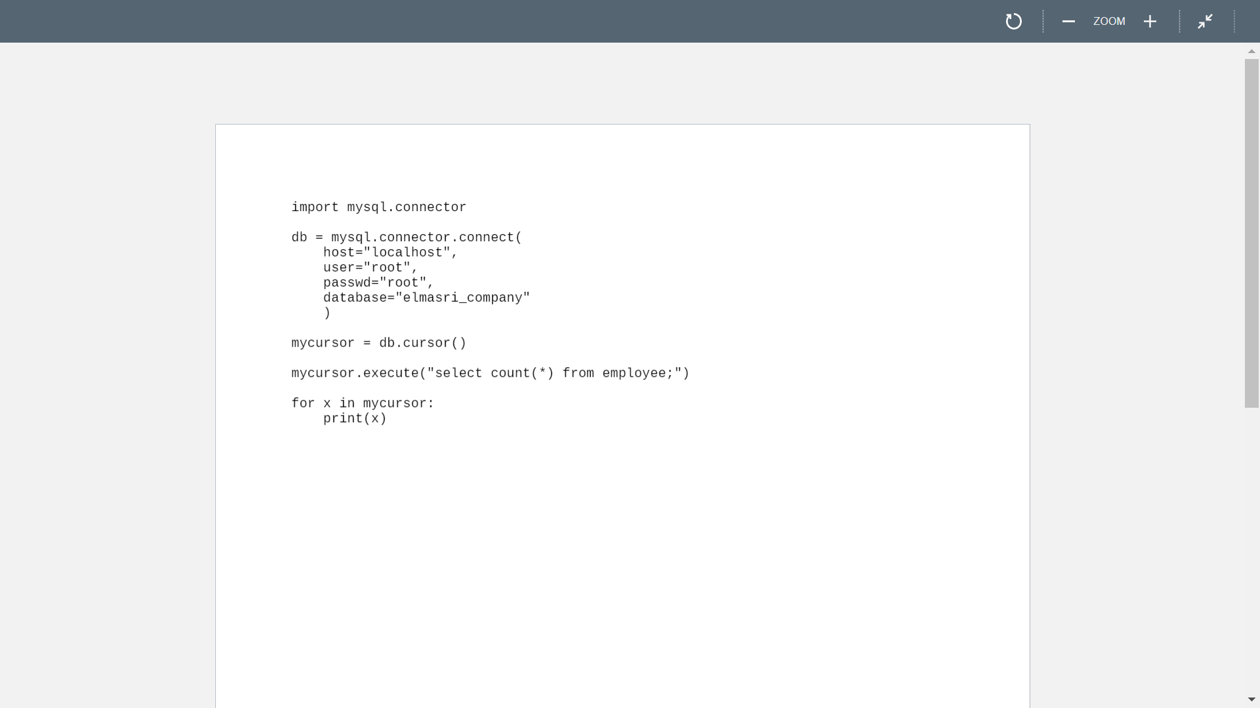
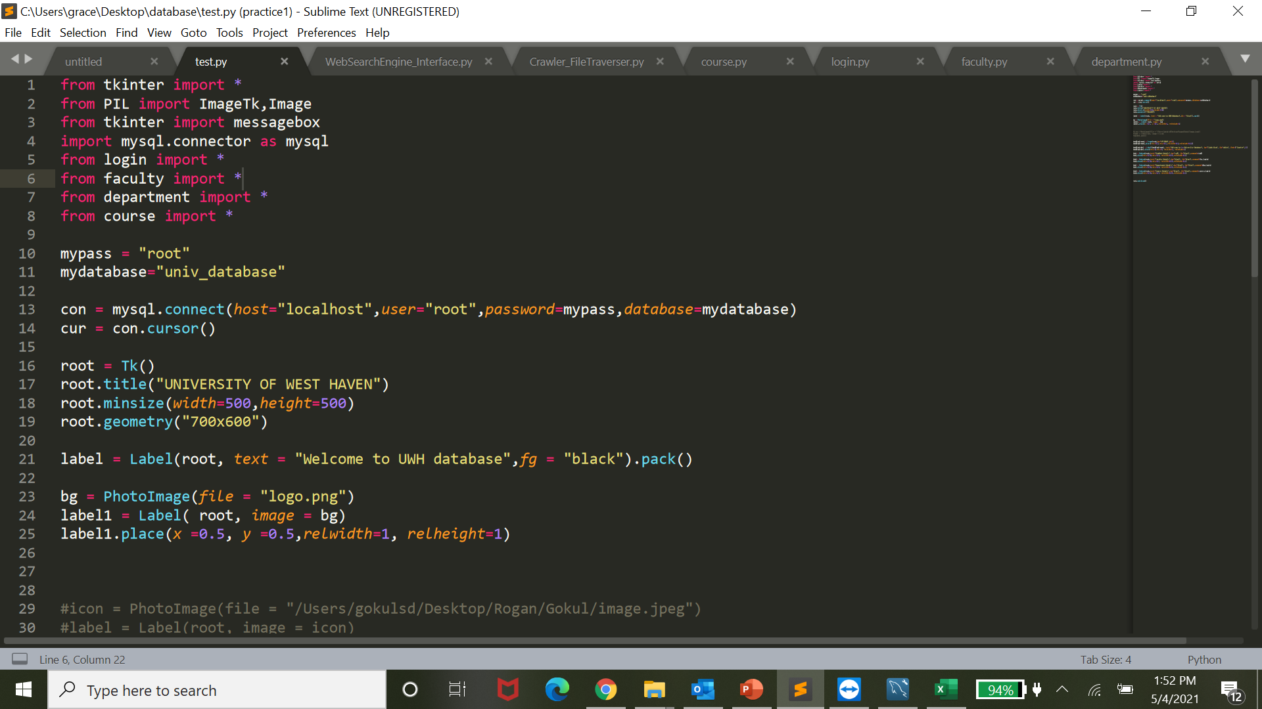
Sql connection- reference code and our database code

Slide 20
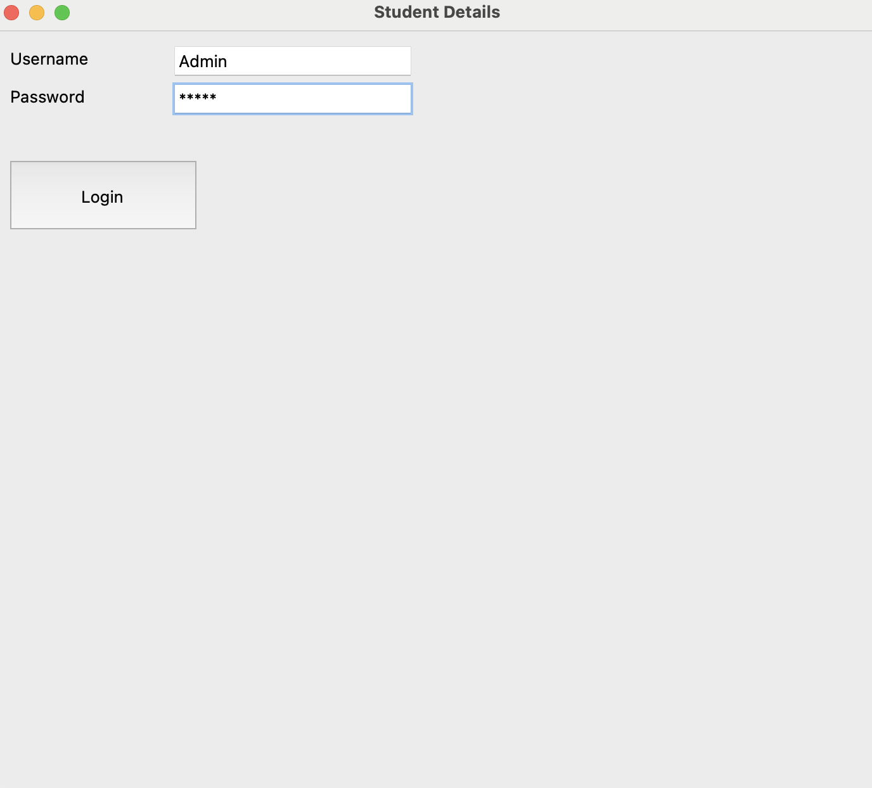
login page

Slide 21

Admin
Using id and password admin can enter into the system
Can insert any student, admin or faculty information.
Can search, edit or delete any account

Slide 22
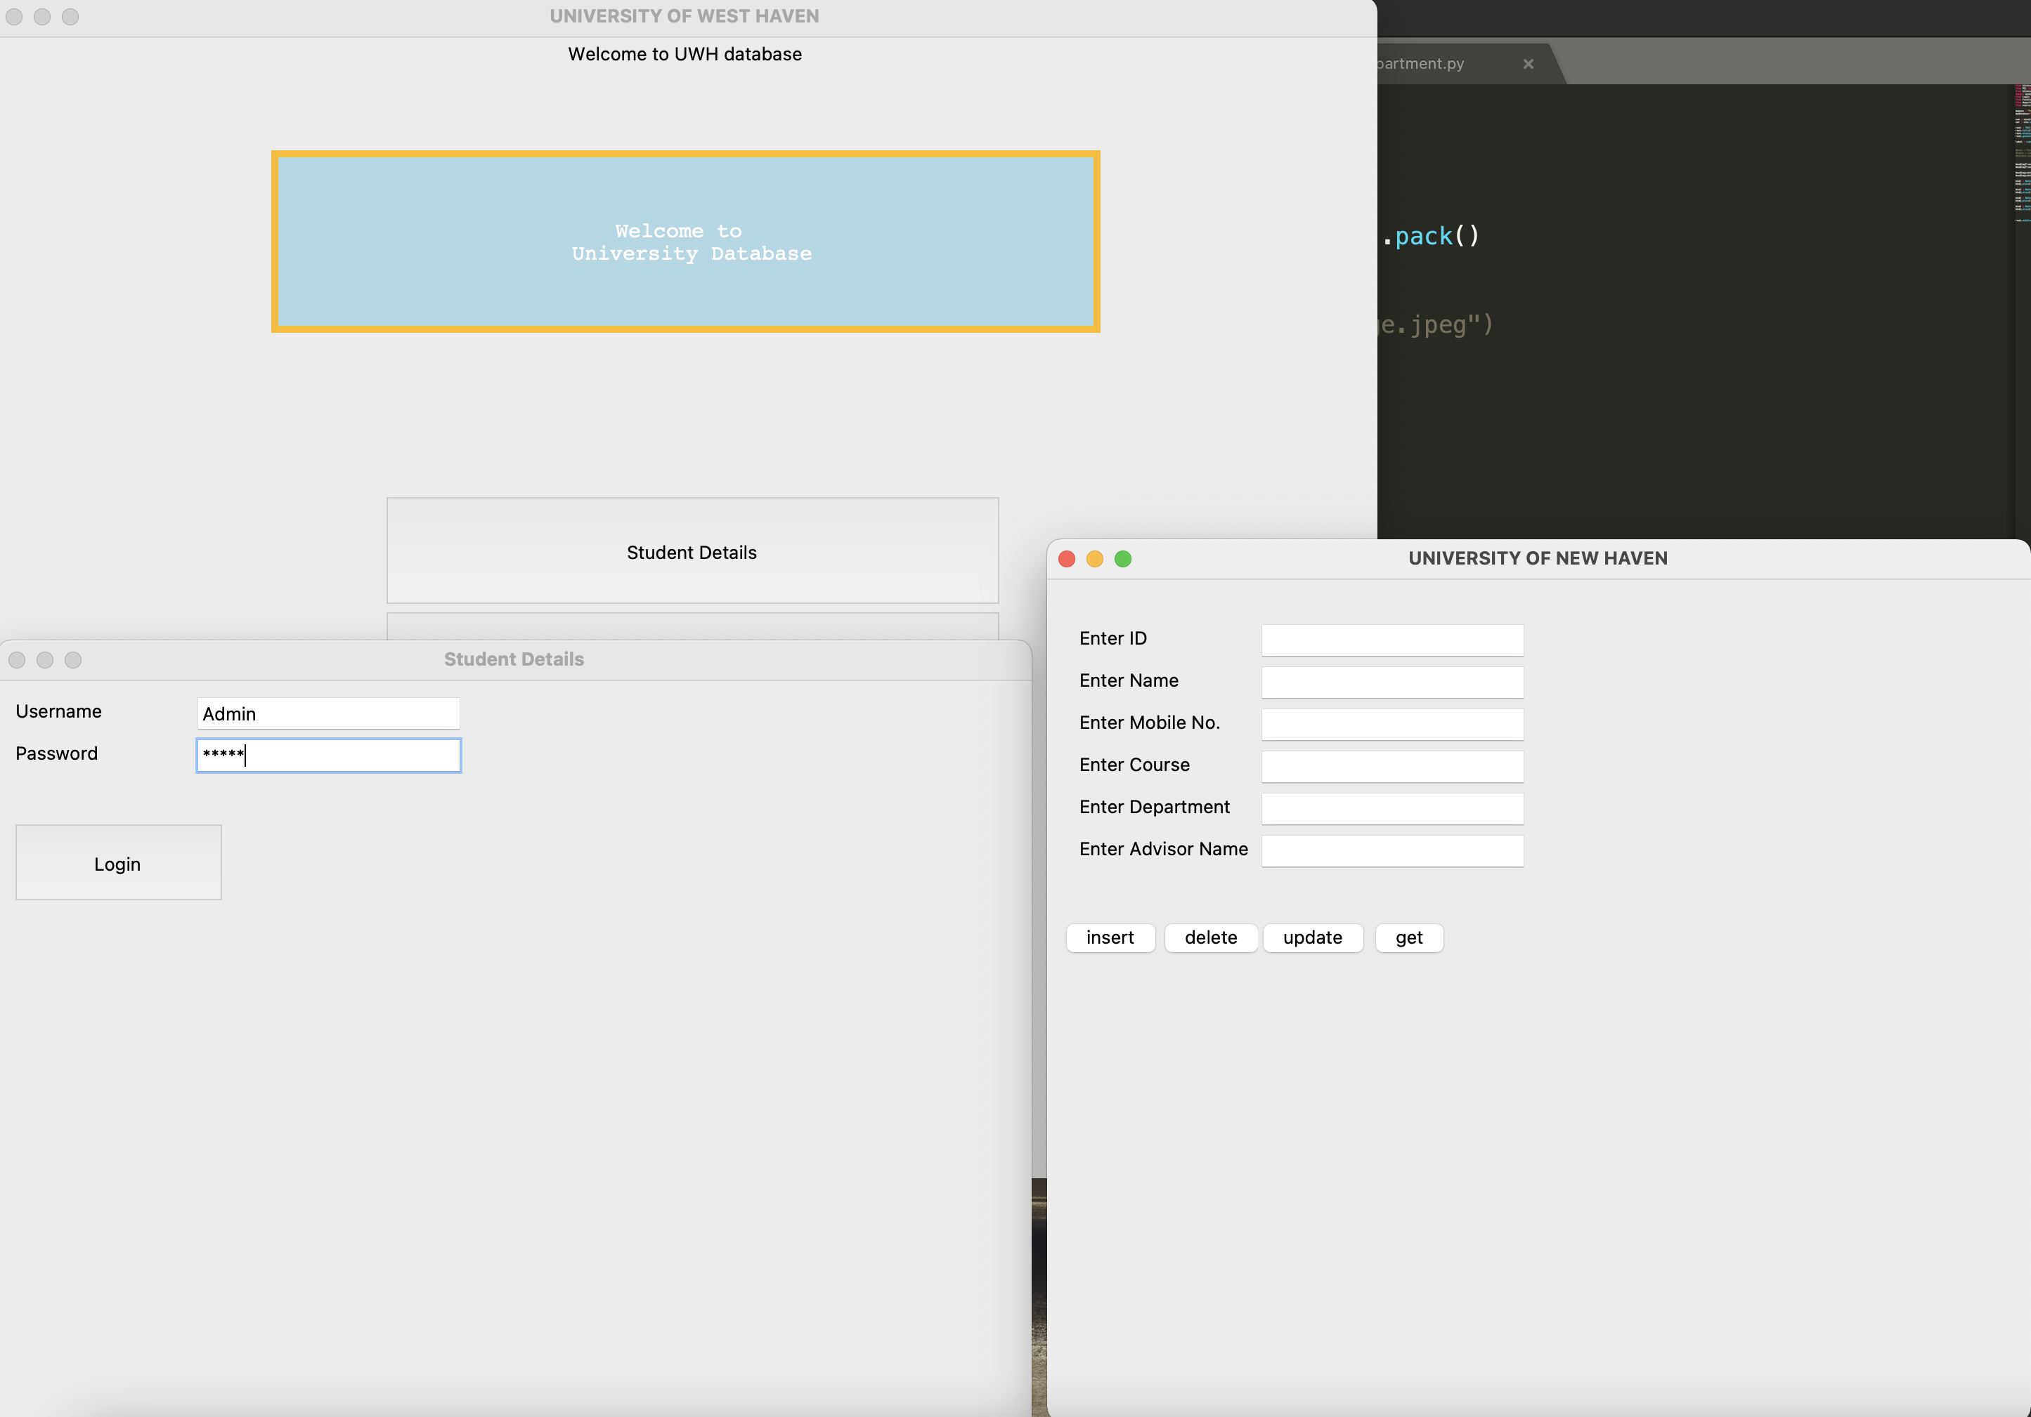
Student login and insertion page

Slide 23
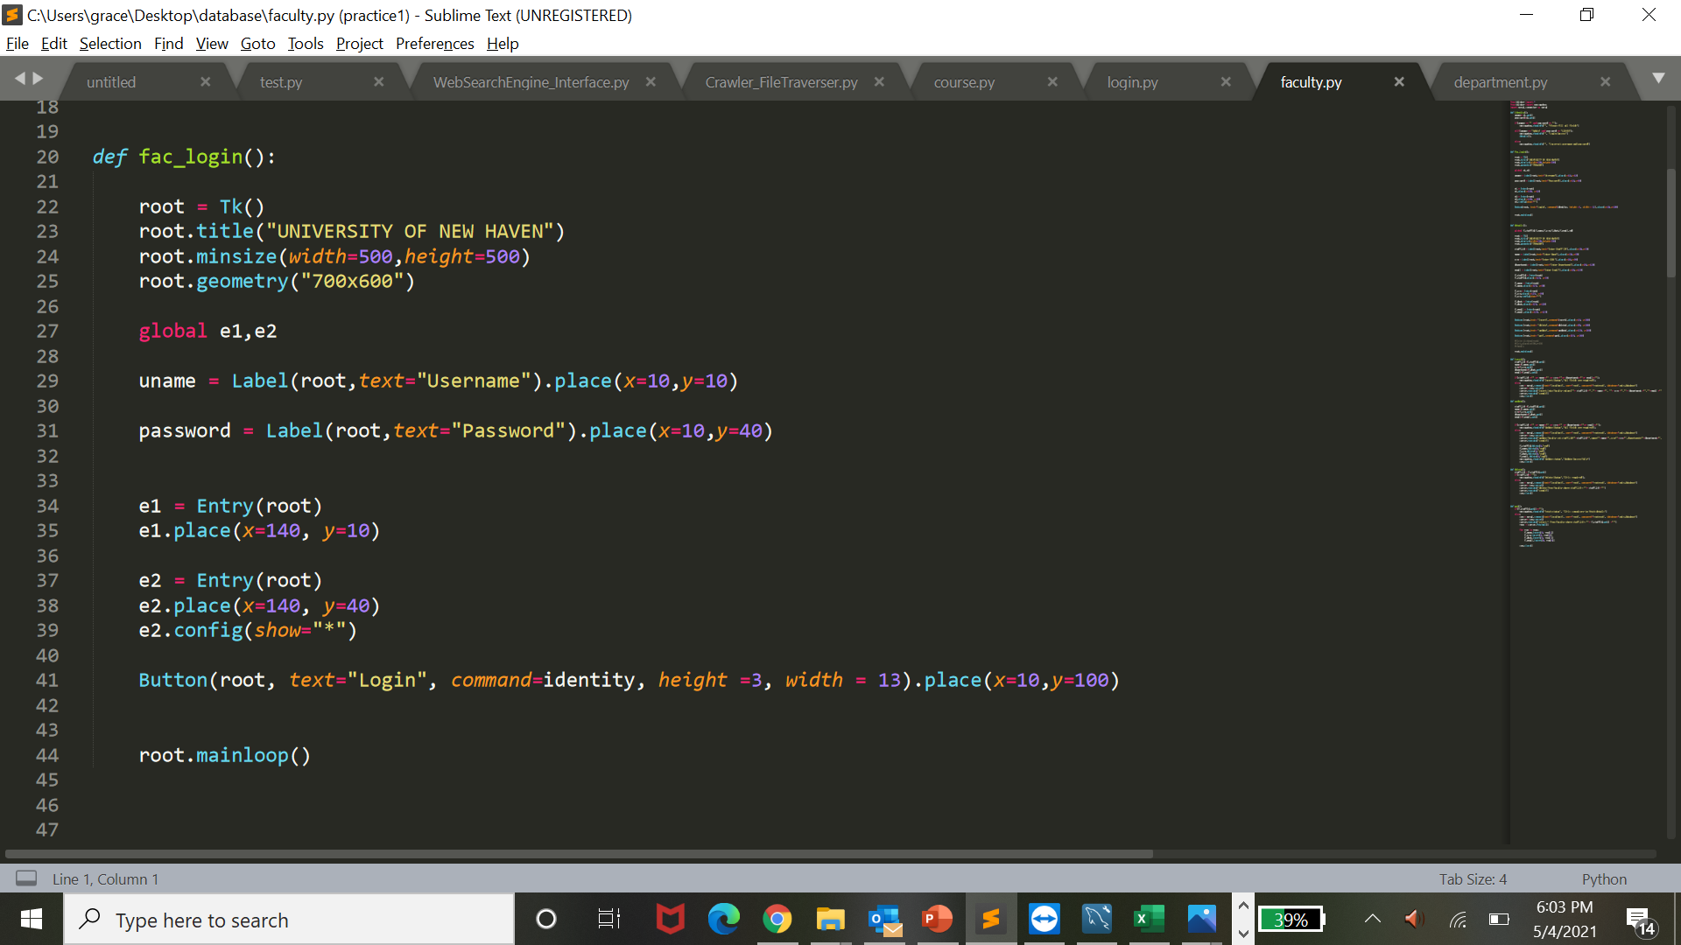
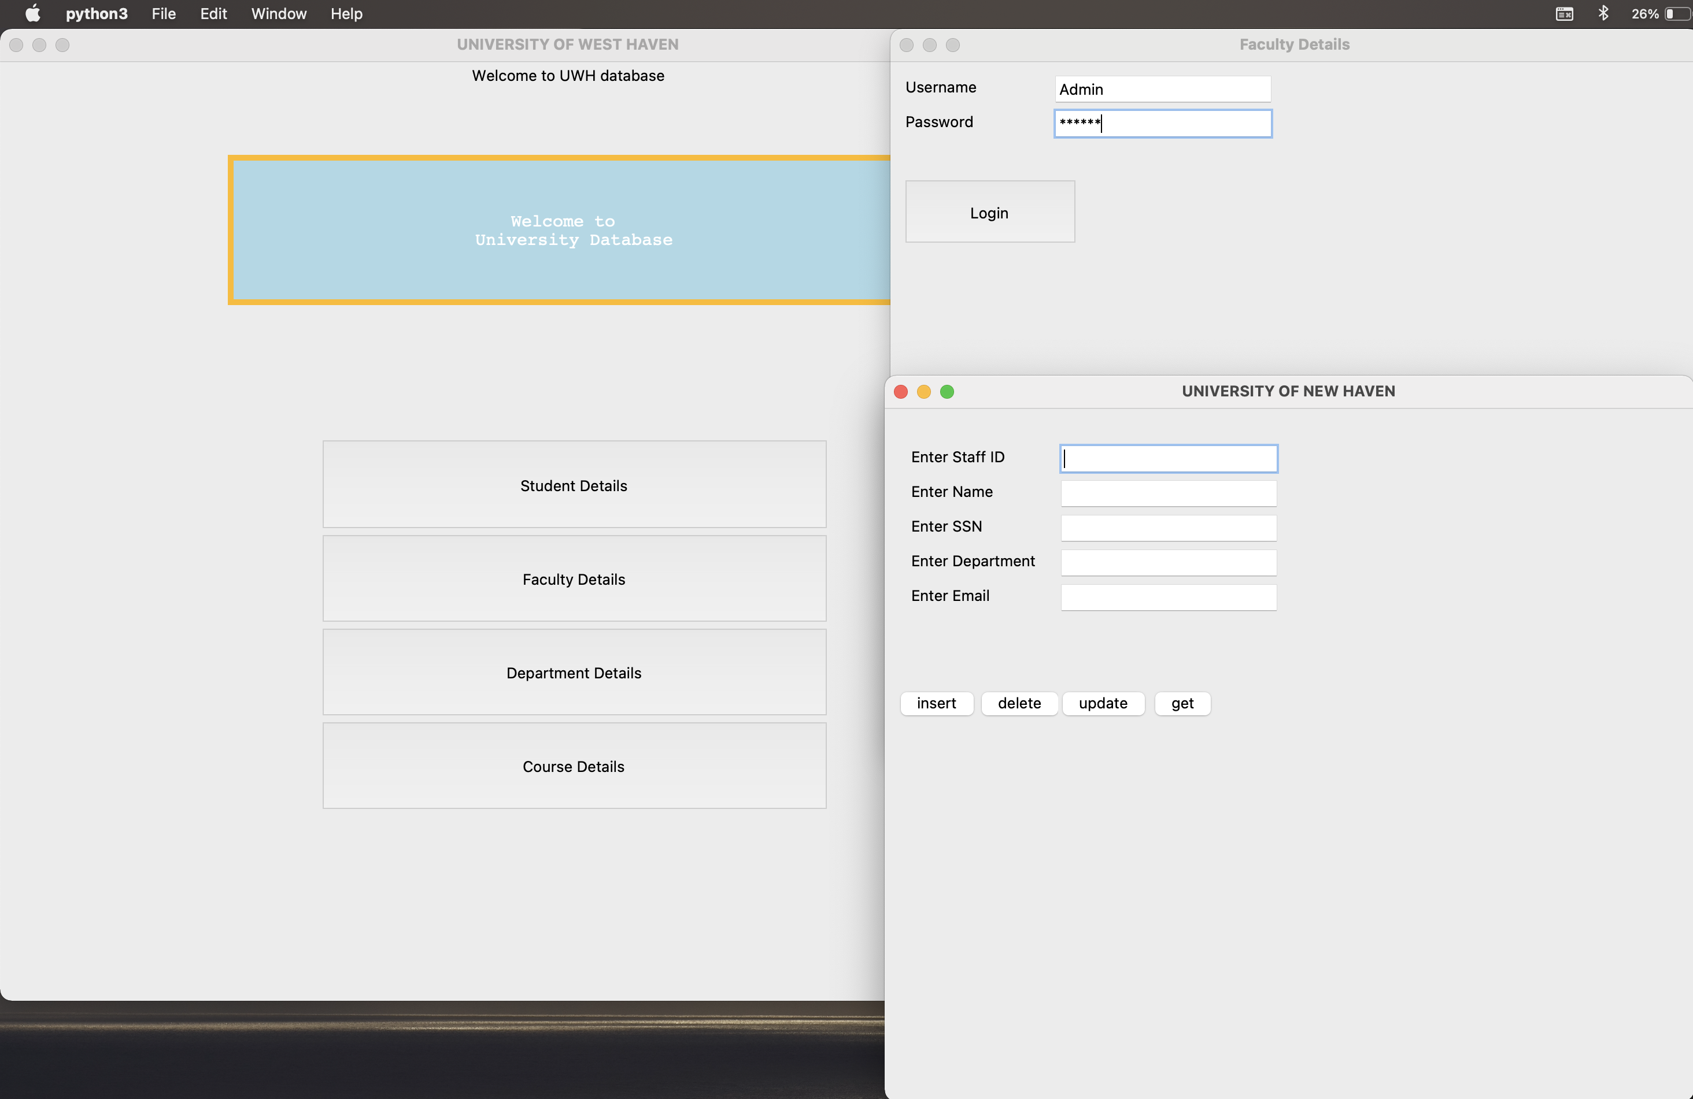
Faculty Login page and insertion page

Slide 24
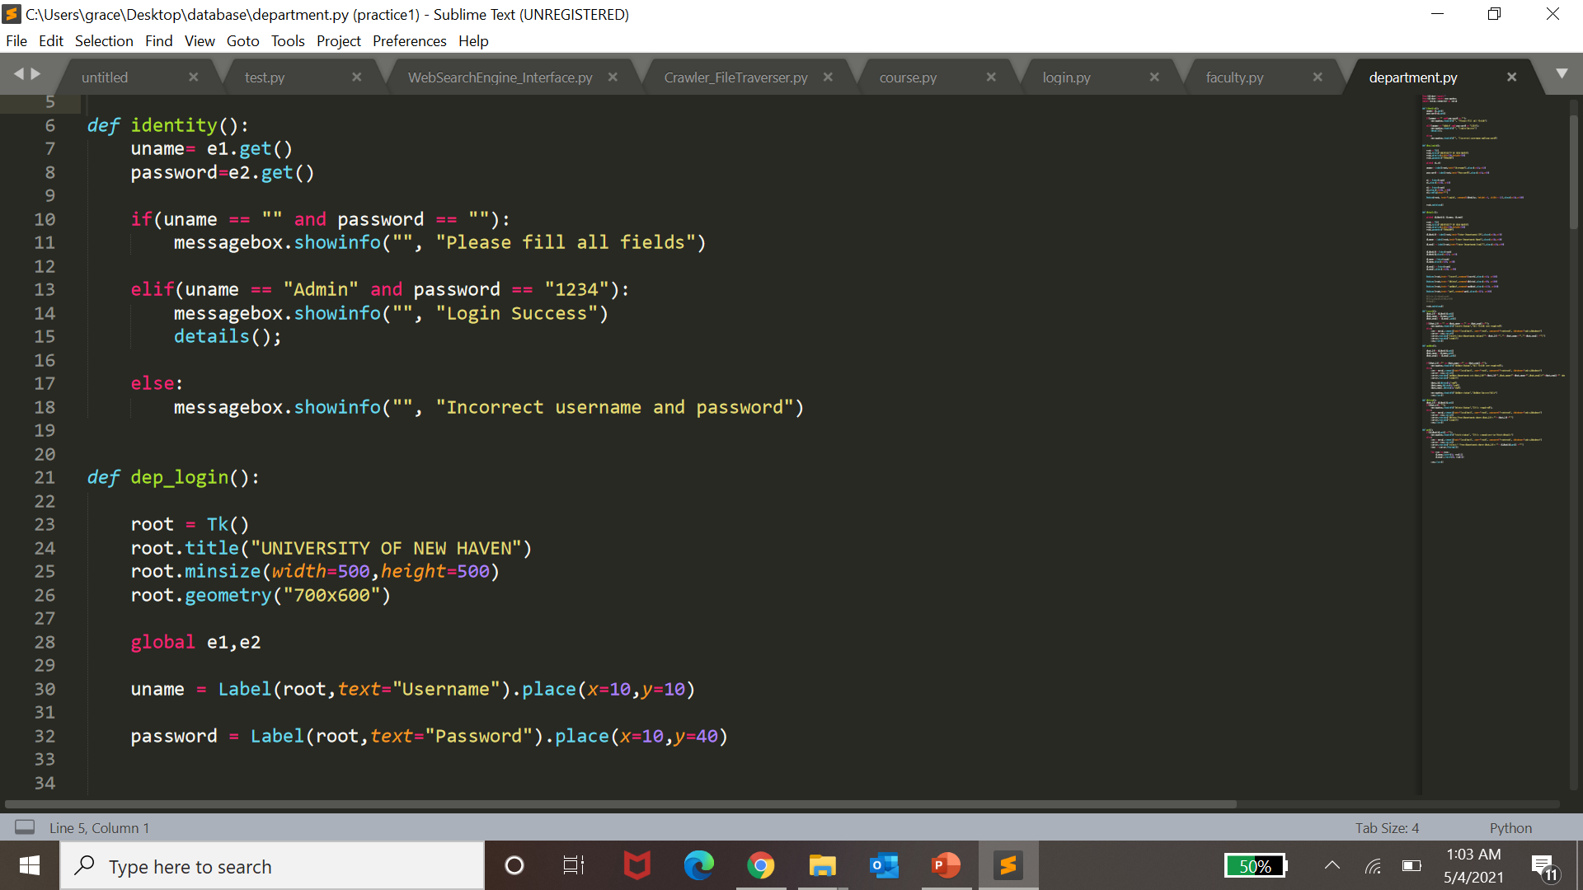
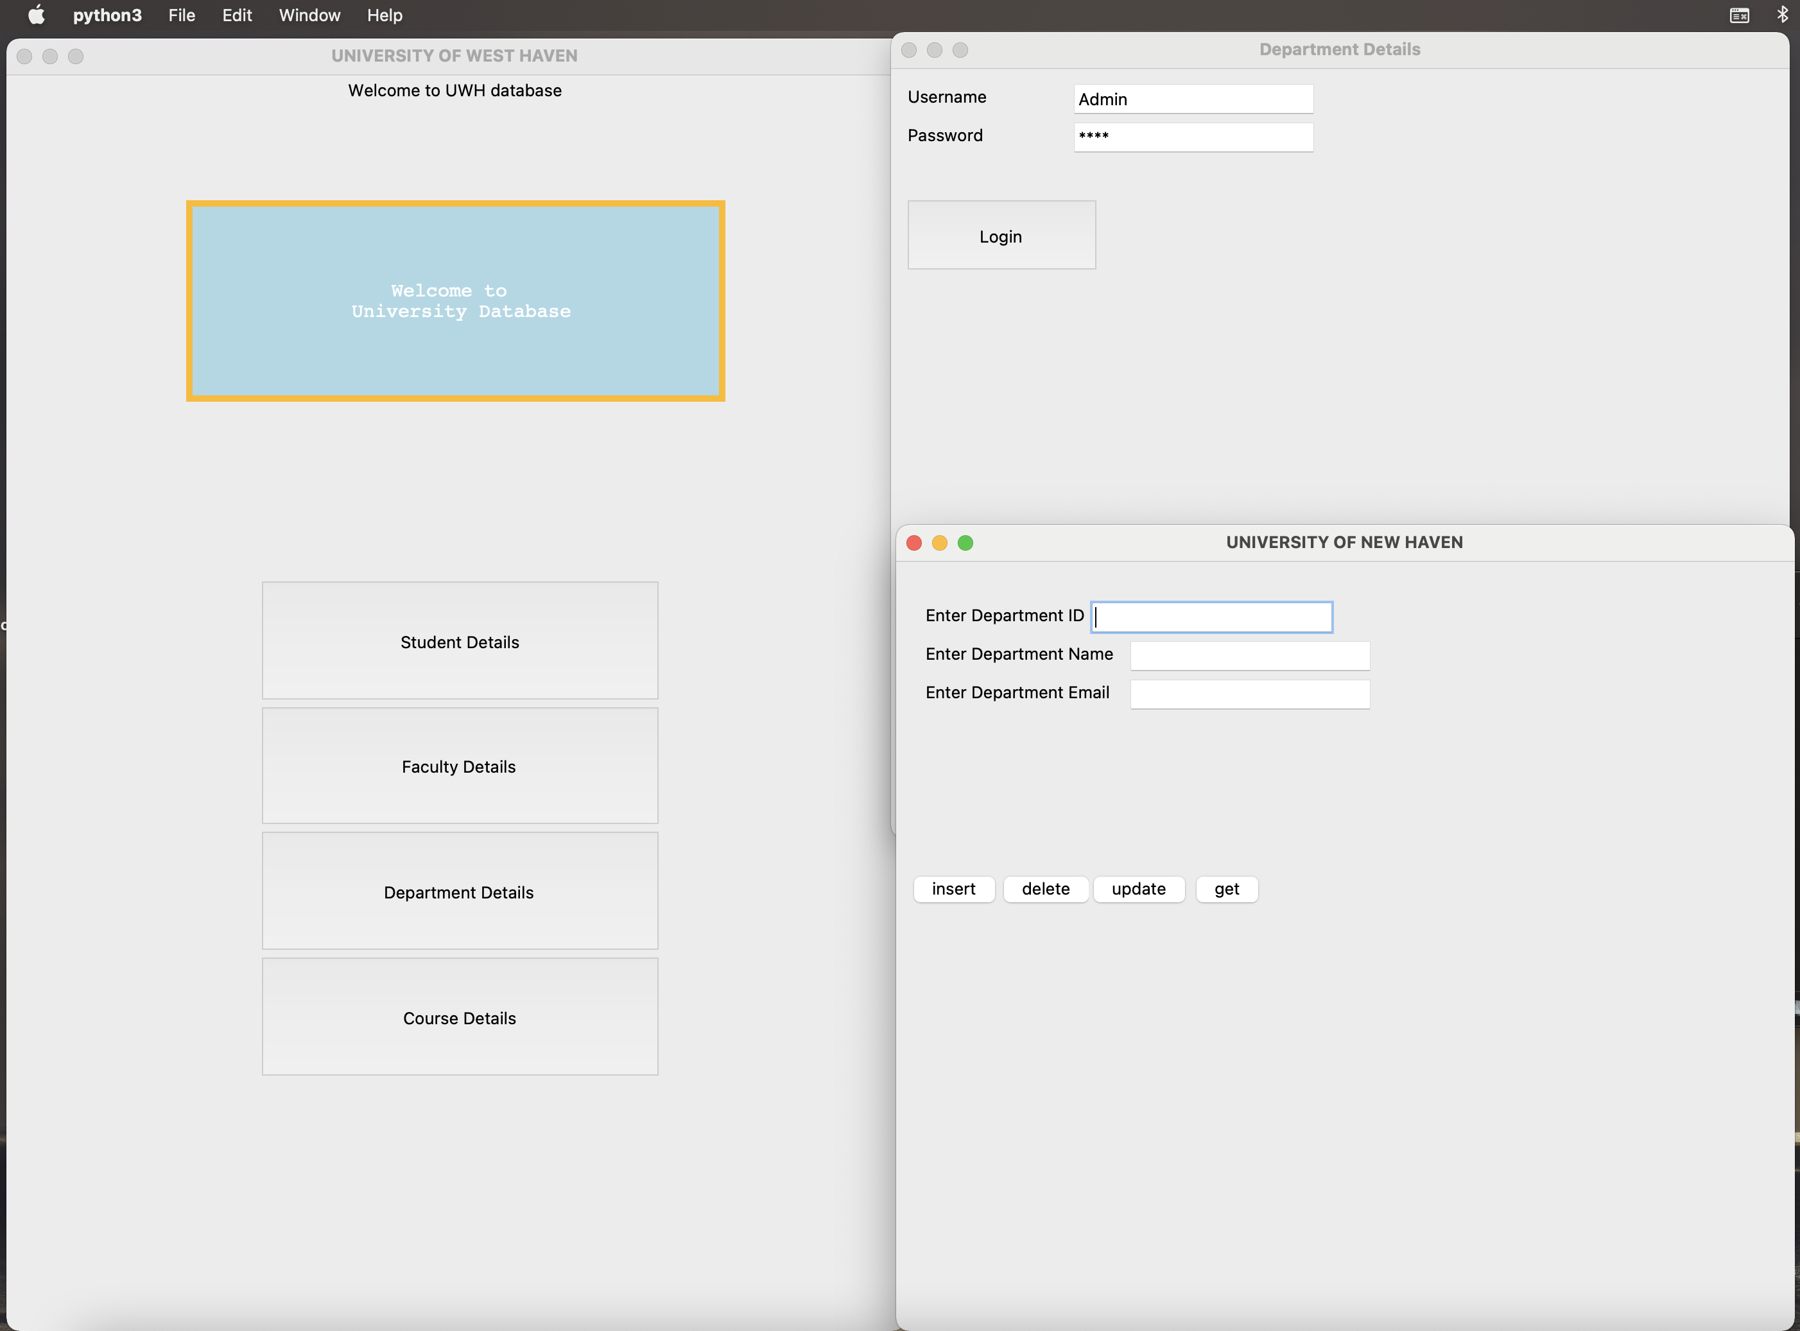
Department page and insertion with code

Slide 25
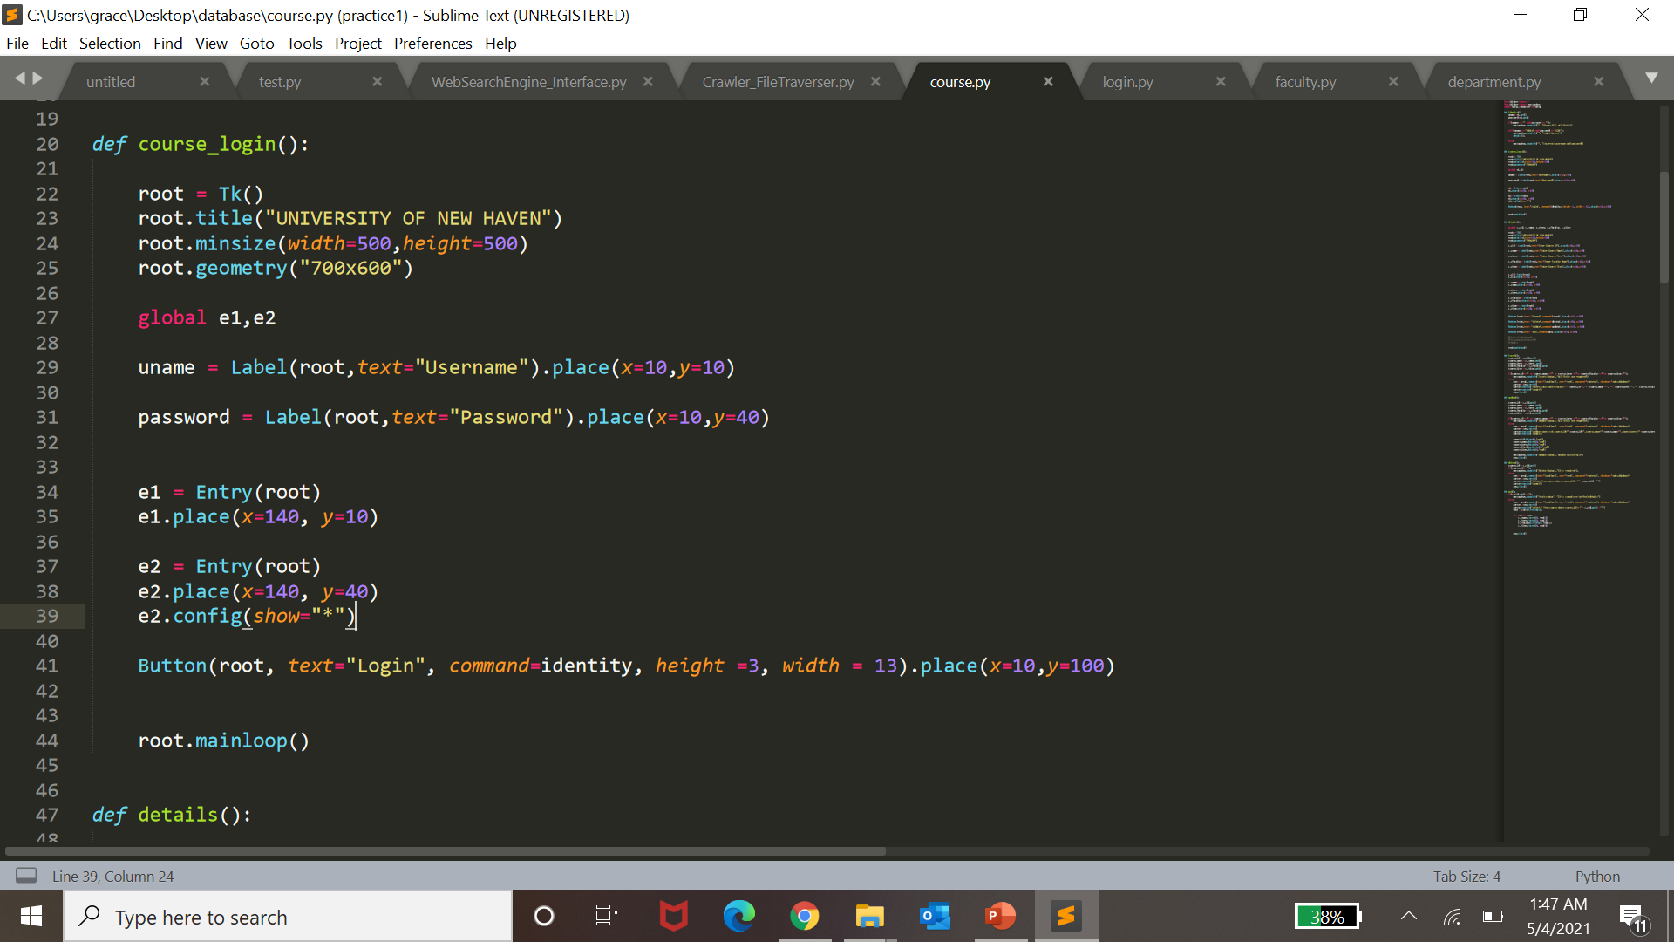
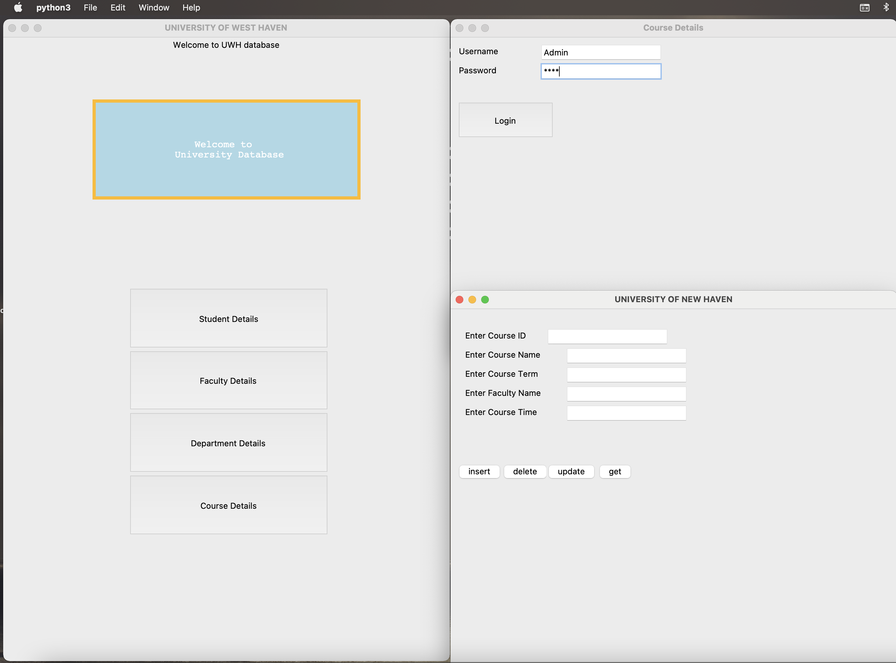
Course login page and insertion with code

Slide 26

FUTURE PLANS
Increasing facilities of this software.
In future we add printing option.
In future we develop graphics design
.In future we connect with online system.
In future we add credit and CGPA of student.

Slide 27
CONCLUSION
It was a wonderful and learning experience for us while working on this project
This software is very easy to use so all educational institute can use this frequently
So, we can hope that our software will be very popular and get sponsors to develop in future.

Slide 28

Thank you

